Slide 1
F2F Meeting 21st May 24

Slide 2
Quick Updates
Began writing the lit review section of the project
Explored 5 potential public datasets (need to settle on one)
Waiting on server access...

Slide 3
What we’re looking for in the public RNA-seq dataset
Data type: RNA-seq data; i.e. whole transcriptome. (single cell, bulk?)
Site: Specific sites in the gut (duodenum, proximal/distal ileum, colon)
Organism: Preferably humans, more realistically mice (C57BL/6N/J).
Quality: Good laboratory practices used, reputable journal
Variables: Control, HFD induced prediabetes or T2DM
Multiple replicates (The more the better)

Slide 4
Using mice as a model for T2DM
Model types:
Dietary (HFD, HFHSD)
Chemical (Streptozotocin)
Genetic (ob/ob, db/db)
Important Factors To Note For Dietary Models:
Duration of the diet (4 to 20 weeks to induce T2DM)
Age of the mice (T2DM is typically ageing disease, mice 24 weeks old ideal)
Formulation of the Diet (HFD plus high fructose to mimic the human diet)
Strain of mouse (C57BL/6J)
Many routes to inducing T2DM: T2DM verification via biological markers is essential:
(fasting hyperglycaemia, impaired glucose tolerance, pronounced hyperinsulinaemia, insulin resistance)

Slide 5
Verifying prediabetes / T2DM
Fasting hyperglycaemia
Impaired glucose tolerance
Pronounced hyperinsulinaemia
Insulin resistance​

Slide 6


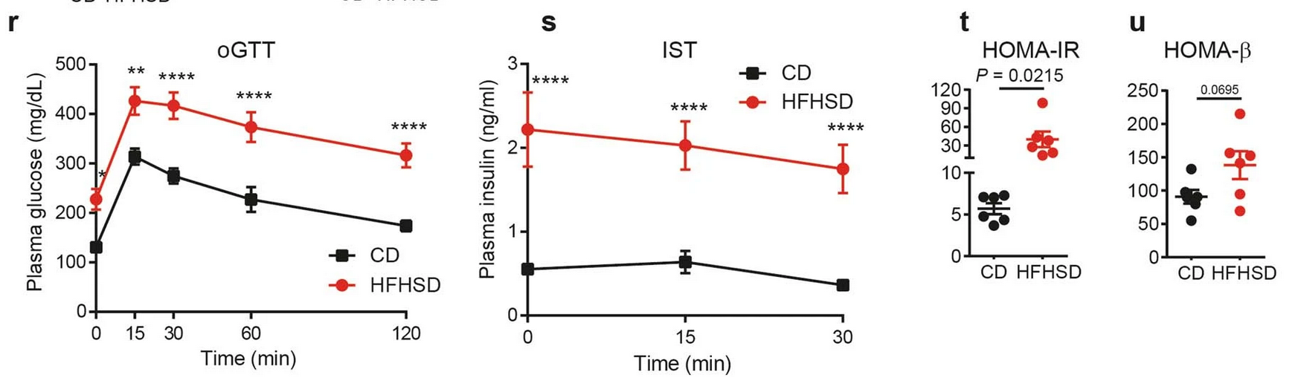
Data Source 1: experimental model
Control Diet
HFHSD
Obese
Prediabetic
Healthy 12 week old mice
0
12 weeks
Oral glucose tolerance test (oGTT)
Insulin secretion test
Estimation of insulin resistance HOMA-IR & HOMA-β

Slide 7
Data Source 1 (Nature - 2021)
https://www.nature.com/articles/s42255-021-00458-9
Data Type: scRNA-seq
Data size: 300 Gb
Site 1: Duodenum, Jejunum and Ileum epithelial crypts
Site 2: Small intestine (SI) villi
Organism: C57BL/6N mouse
Variables: Control & HFHSD, diabetes verified (obesity, glucose intolerance, hyperinsulinaemia, insulin resistance)

Slide 8
Data Source 2: experimental model
UCD-T2DM Rat
(ND) Non-diabetic
10 weeks old
UCD-T2DM Rat
(RD) Non-fasting blood glucose > 300 mg/dl for 2 weeks
24 weeks old
UCD-T2DM Rat
(LD) Non-fasting blood glucose > 300 mg/dl for 21 weeks
24 weeks old

Slide 9
Data Source 2 (Physiological Reports - 2021)
https://www.ncbi.nlm.nih.gov/pmc/articles/PMC8606862/
Data Type: RNA-seq
Data size: Unknown, waiting on response from Dr. Picollo
Site: Ileum & Colon
Organism: UCD-T2DM Rat (Prediabetic from birth)
Variables: ND, RD, LD (Non/Recent/Long diabetic)
No good healthy control exists. The non-diabetic group are prediabetic from birth.
The mice are fed a standard ‘chow’ diet and sporadically develop diabetes.

Slide 10
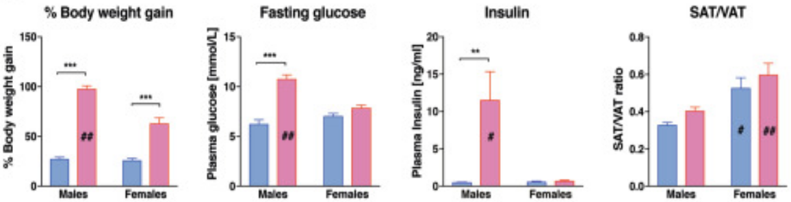

Data Source 3: experimental model
Control Diet
High Fat Diet
5-6 week old mice
13 week diet
E2 for last 3 weeks in male group
High Fat Diet

Slide 11
Data Source 3 (Nature - 2020)
https://www.ncbi.nlm.nih.gov/pmc/articles/PMC7527340/
Purpose of study: Measure impact of estrogen in developing metabolic syndrome
Data Type: RNA-seq
Data Size: 23.5 Gb
Site: Colon
Organism: C57BL/6J mouse
Variables: Control diet / HFD

Slide 12
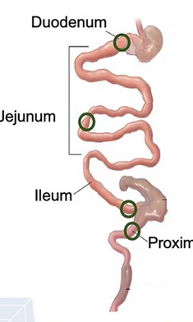
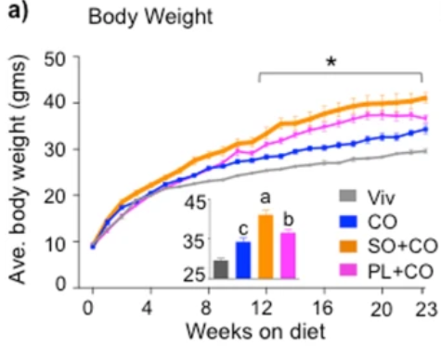
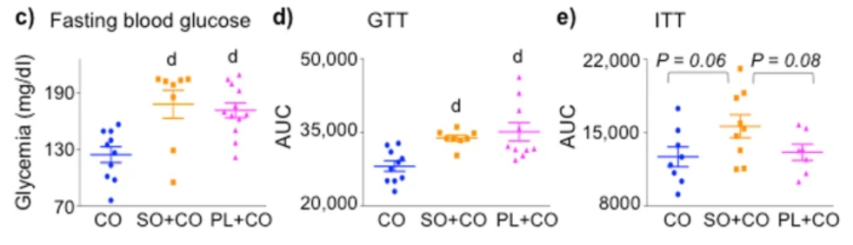
Data Source 4: experimental model
Control Diet
HFD (Coconut Oil)
HFD (Soybean Oil)
HFD (Plenish Oil)
3 weeks old
24 weeks old

Slide 13
Data Source 4 (Nature - Dec. 2023)
https://pubmed.ncbi.nlm.nih.gov/38151490/
Data Type: RNA-seq
Data Size: 47 Gb
Site: duodenum, jejunum, terminal ileum, proximal colon
Organism: C57BL/6N
Variables: Control diet / HFD

Slide 14
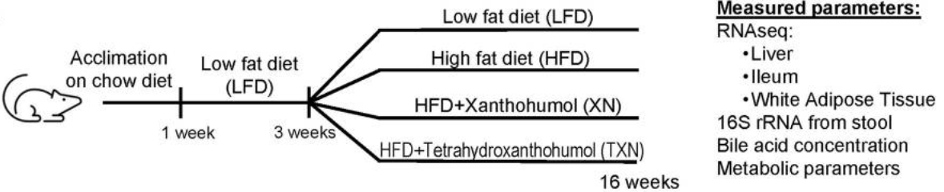
Data Source 5: experimental model
Diet-induced mouse model of obesity and metabolic disease
Metabolic Syndrome: Verified through measurements of fasting LDL, cholesterol, glucose, insulin, and leptin, glucose tolerance, liver TAGs, and weights of brown adipose tissue (BAT) and mesenteric fat pads

Slide 15
Data Source 5 (BMC Microbiome - Sep. 2023)
https://www.ncbi.nlm.nih.gov/pmc/articles/PMC10512512/
Data Type: RNA-seq
Data Size: 1.3 Gb
Site: Ileum 10 replicates
Organism: C57BL/6J
Variables: Control diet / HFD
Metabolic Syndrome: Verified through measurements of fasting LDL, cholesterol, glucose, insulin, and leptin, glucose tolerance, liver TAGs, and weights of brown adipose tissue (BAT) and mesenteric fat pads

Slide 16
Next steps
Select a public dataset
Gain access to server for storage/computing
Develop a data analysis pipeline
Gather meaningful insights from the selected data for the June 18th meeting

